Slide 1
VOLATILITY COLLEGES IN THE NBA DRAFT
Jack Tobia, Noah Tervalon, & Jake Lawton

Slide 2
ROADMAP
01
02
03
04
05
06
MOTIVATION
GOALS AND OBJECTIVES
MEASUREMENT
AND EVALUATION
RESULTS
WHAT WE CAN DO WITH THIS
CONCLUSION

Slide 3
01
MOTIVATION

Slide 4


WE WANTED TO ANSWER…
Which colleges are the most risky to draft from?
How consistently are colleges pumping out good players?
Is there a way to use statistics to more securely draft good basketball players?

Slide 5
02
GOALS AND OBJECTIVES

Slide 6
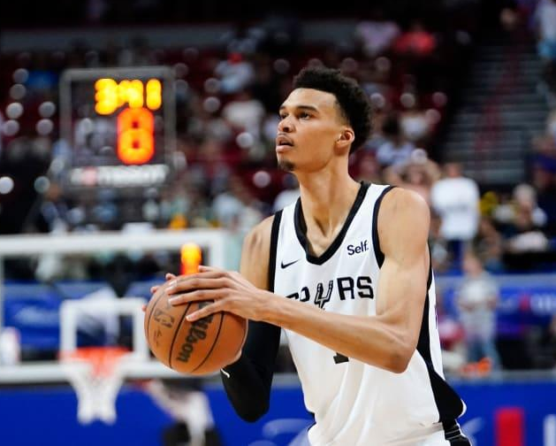
THREE GOALS
PROVIDE RISK ASSESSMENT
IDENTIFY VOLATILITY PATTERNS
HIGHLIGHT CONSISTENCY VS. VARIABILITY
Notes:
We want to see which colleges are the most volatile in general
Given this volatility, which colleges are the most risky to draft from
Showcase which colleges are reliable sources of talent (or failure) and which ones are more unpredictable

Slide 7
03
MEASUREMENT AND EVALUATION

Slide 8
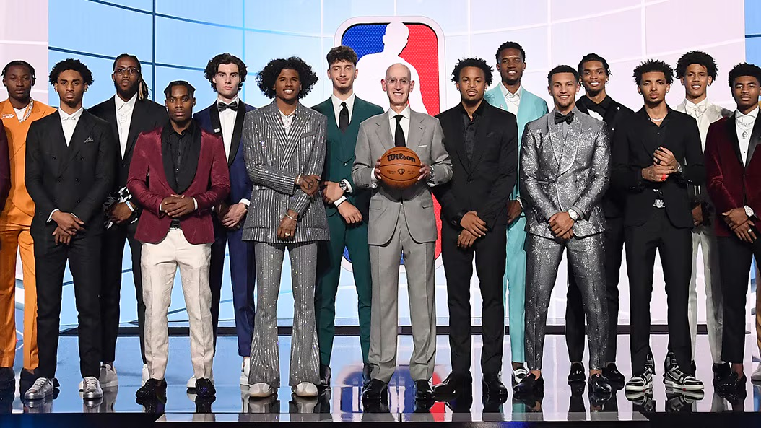
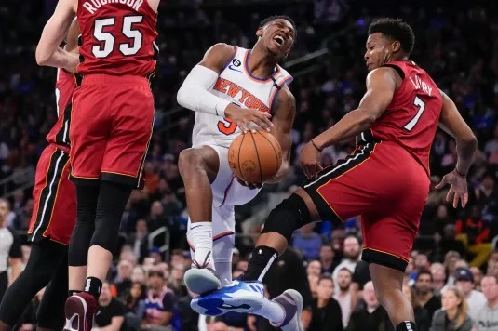
OUR DATA
DRAFT PICKS W/ COLLEGES
NBA PLAYER STATS
Provides information on the draft directly from the NBA’s website, including where they were drafted from, what year, and what round
Contains player performance data by the season, which will help us get overall ratings per season, starting from each player’s rookie year

Slide 9
HOW WE USED IT
GROUP UP BY COLLEGE
MAKE OVERALL RATINGS
Group together all players that were drafted from the same college
Make a list of overall ratings for each player for each season they played in using a formula that fairly weighs the statistics we receive from the CSV file
BE SELECTIVE
PRODUCE A RESULT
Take out data points that are not useful to us by selecting the time frame, removing sets of data that are too small to gather information from, etc.
Use these data points in congruence with each other to determine which colleges pump out consistently good/mid players and which colleges pump out inconsistent players

Slide 10

SOME RESTRICTIONS WERE NECESSARY
Turns out that not all the data provided to us was necessary. We had to cut out details to make our results actionable:
If a college drafts less than 5 players in history, then the volatility cannot be accurately measured since one player would have too much pull
We only took statistics from players’ first four seasons (the length of a rookie contract)
Disregard anything less than 4 seasons
Disregard long-term success
If a name appeared in the list of draft picks but not in the data set, then no statistics were taken for that player

Slide 11
Player Value
How we did it

Slide 12
Our beautiful formula (it’s not ours)
EFF = P + RB + AST + STL + BLK - (FGA - FG) - (FTA - FT) - TOV
Notes:
Commonly-used formula, it fit our data set nicely, and reflects crucial parts of the game.

Slide 13
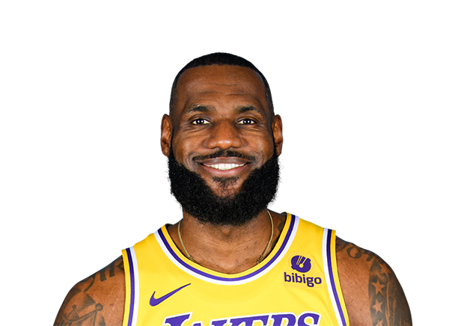
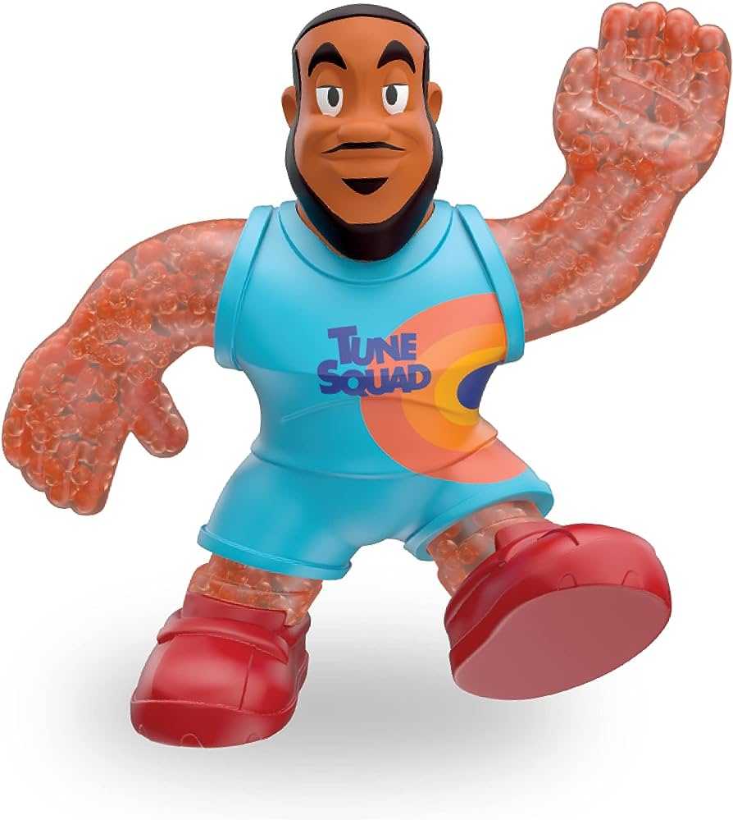

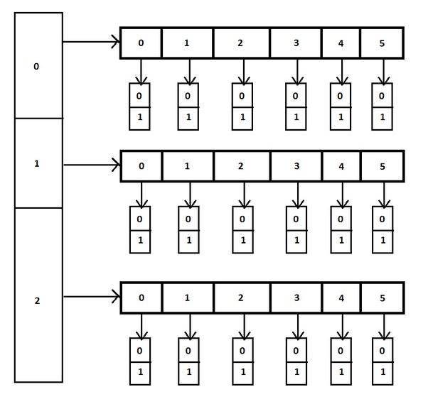
CS15 - DATA STRUCTURES
For each player, we calculated an EFF for each of their first four seasons, then got their average EFF
1
2
For each school, calculated their drafted players’ average EFF and standard deviation
LEBRON JAMES
39, my sunshine
“I DON’T READ BOOKS MUCH.”
“I LOVE HASH TABLES.”
Used all schools’ EFF and standard deviation to calculate overall security/success
3
(our data would look something like this)

Slide 14

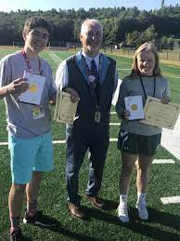

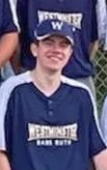

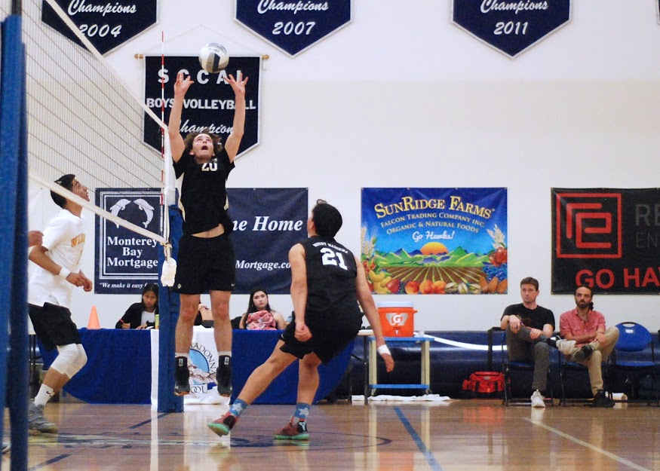
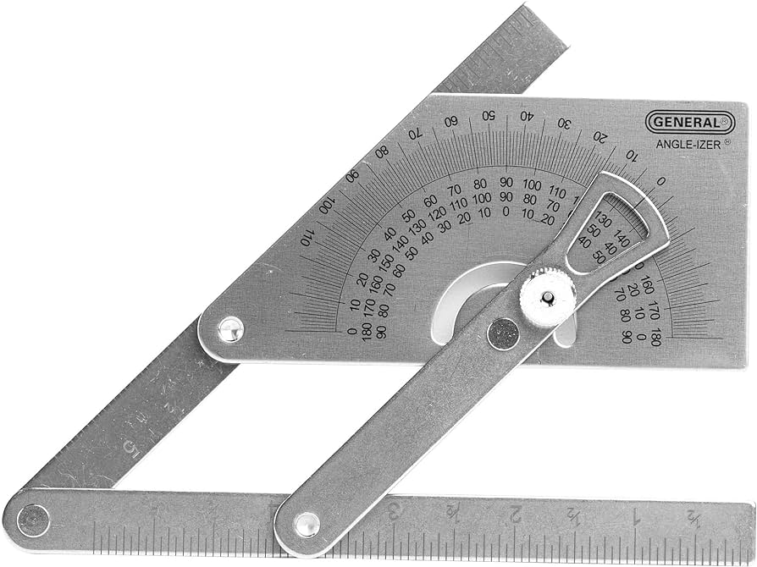





WE DID SOME MATH
Notes:
We coded it but still

Slide 15
04
RESULTS

Slide 16



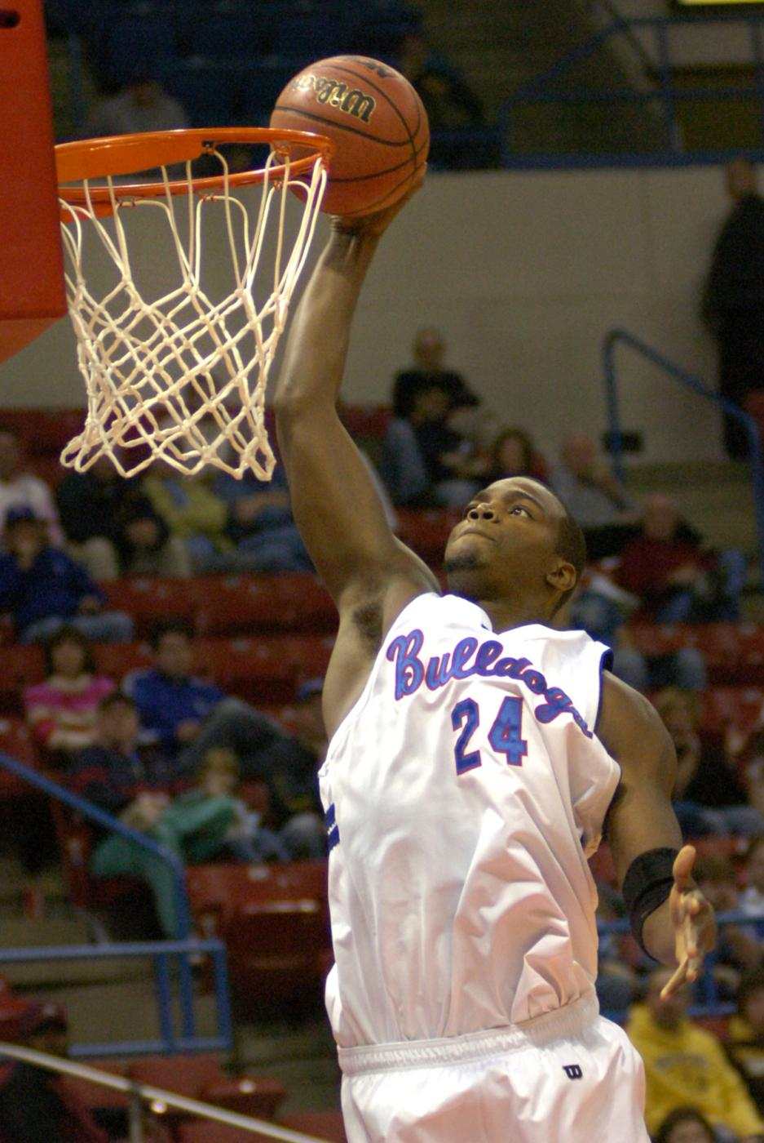
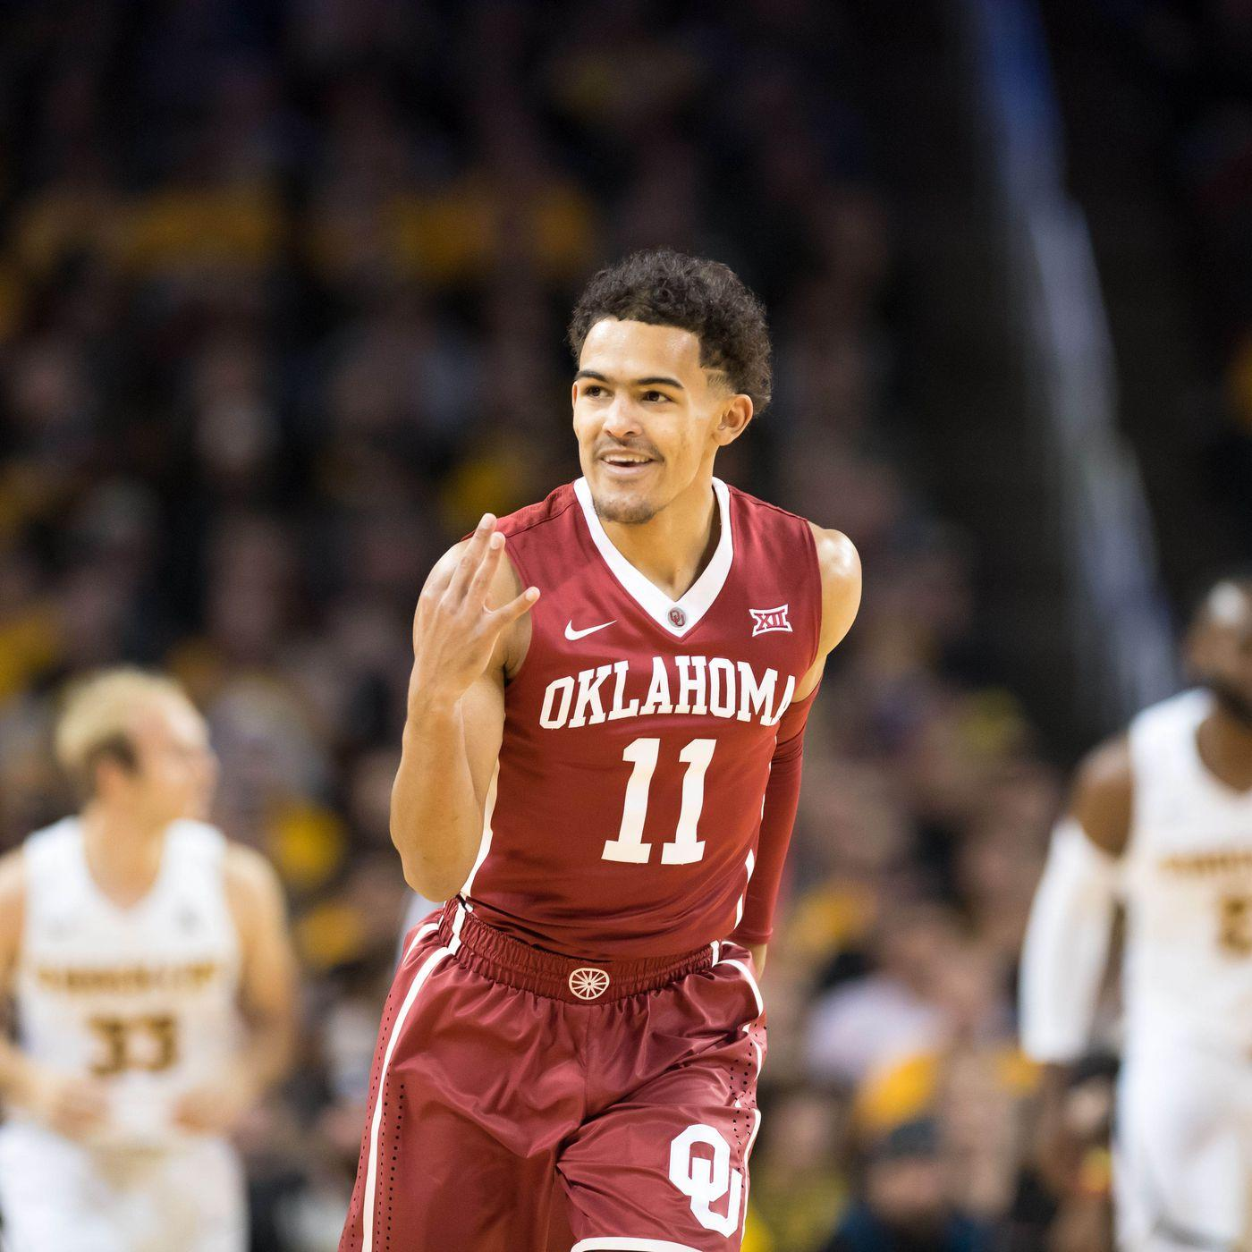
COLLEGES PUMPING OUT THE BEST (ON AVERAGE)
Louisiana Tech
Oklahoma
Houston
Average Value of Player:
17.34
Notable Players:
Paul Millsap, Karl Malone, P.J. Brown
Average Value of Player:
15.71
Notable Players:
Trae Young, Blake Griffin, Buddy Hield
Average Value of Player:
15.68
Notable Players:
Hakeem Olajuwon, Clyde Drexler, Quentin Grimes
Honorable Mentions: Georgetown (15.26) Central Michigan (14.55) Kentucky (13.96)

Slide 17



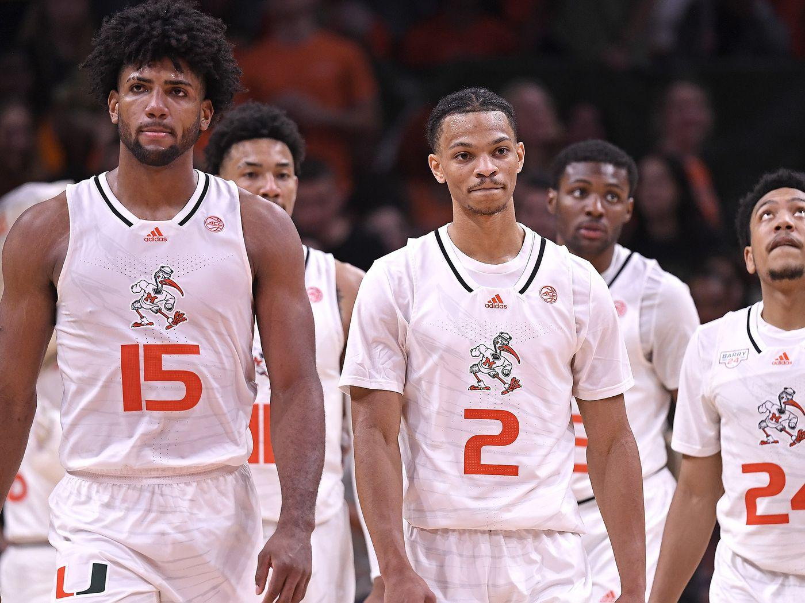
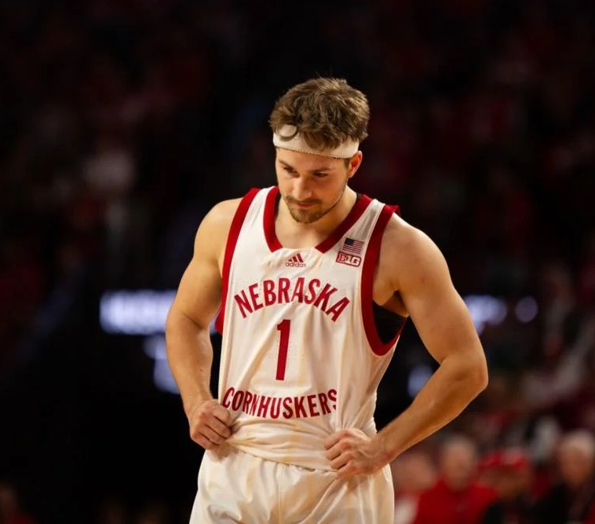
COLLEGES PUMPING OUT THE WORST (ON AVERAGE)
Nebraska
Miami (FL)
Bradley
Average Value of Player:
5.94
Average Value of Player:
6.95
Average Value of Player:
7.51
Honorable Mentions: Vanderbilt (7.53) Oral Roberts (7.6) Fresno State (7.8)

Slide 18
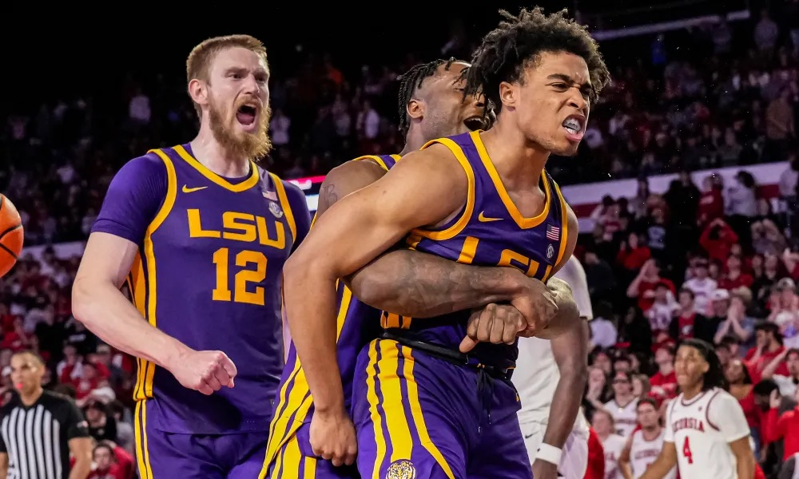


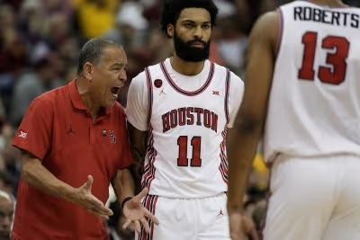
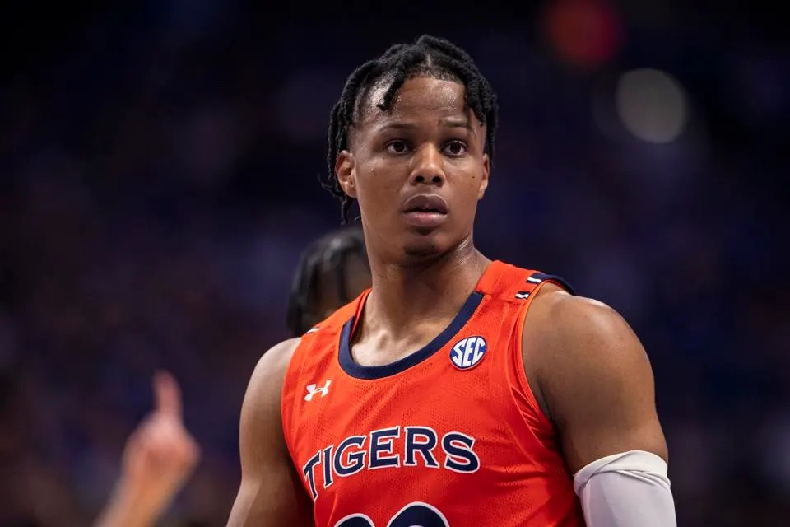
RISKIEST COLLEGES TO DRAFT FROM
Houston
Louisiana State
Auburn
σ = 9.7
σ = 8.87
σ = 8.83
Honorable Mentions: Wake Forest (8.05) Georgetown (8.03) Purdue (7.91)
Note: Excluding Purdue, all teams are in top 17 of average player rating, out of 89 colleges used

Slide 19
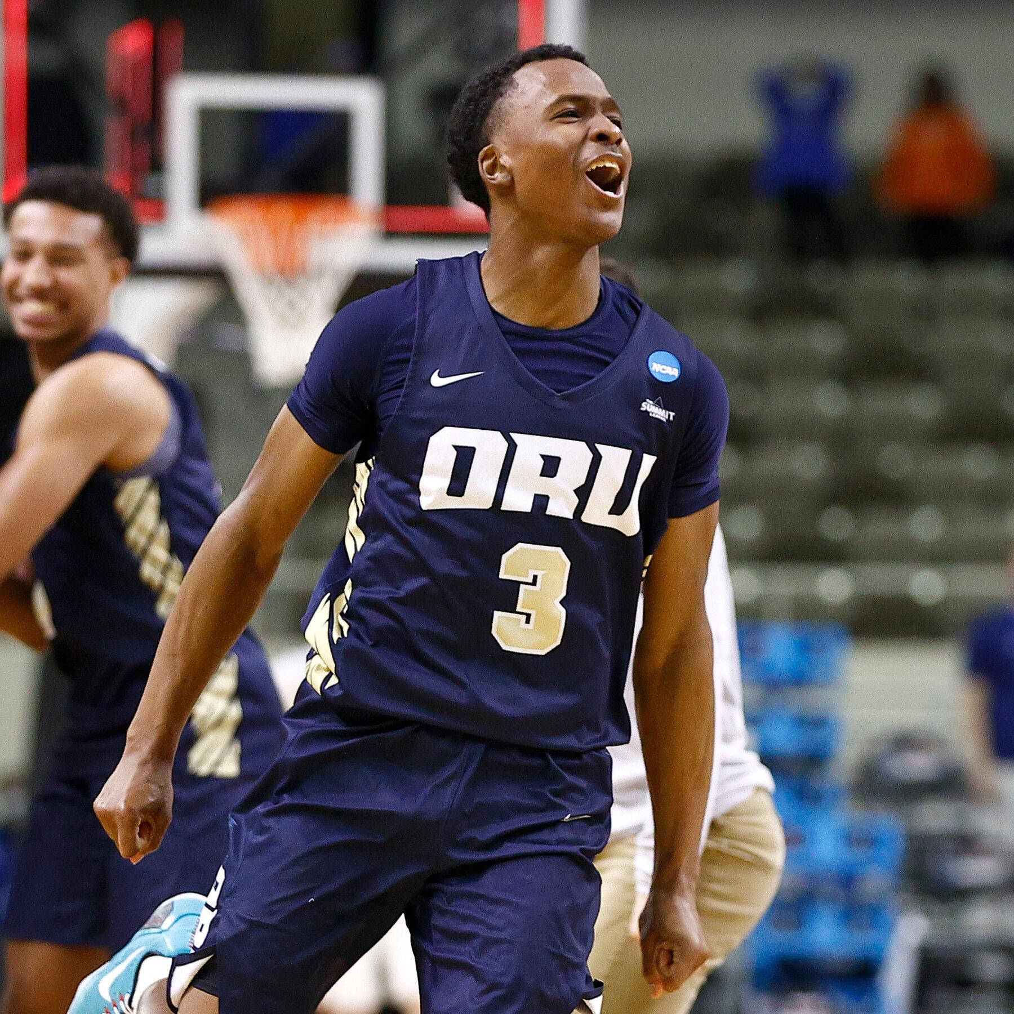



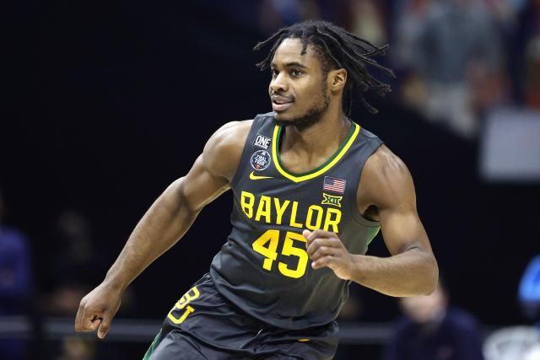
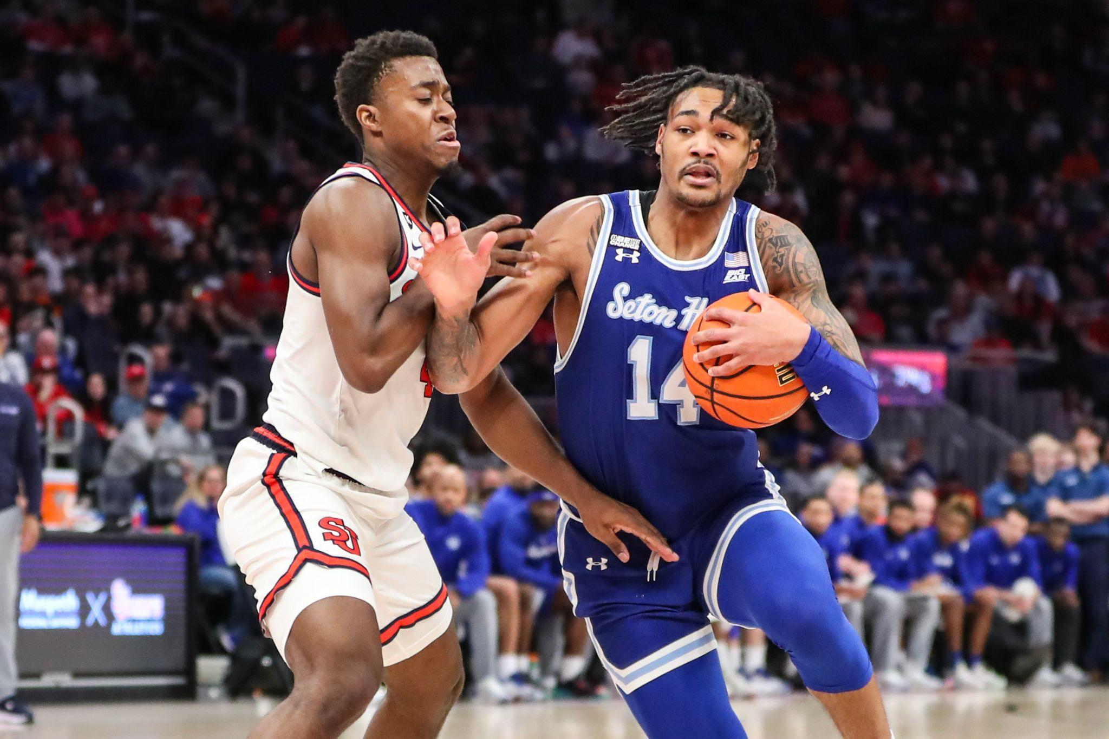
CONSISTENT COLLEGES
Oral Roberts
Baylor
Seton Hall
σ = 1.34
σ = 2.14
σ = 2.26
Honorable Mentions: Virginia Tech (2.43) Iowa (2.56) Nebraska (2.57)
Note: all teams are in bottom 17 of average player rating, out of 89 colleges used

Slide 20
05
WHAT WE CAN DO WITH THIS
Notes:
Talk about aligning picks with college teams that have CONSISTENTLY GOOD players, and knock out CONSISTENTLY BAD, while being weary of INCONSISTENTLY GOOD/BAD.

Slide 21
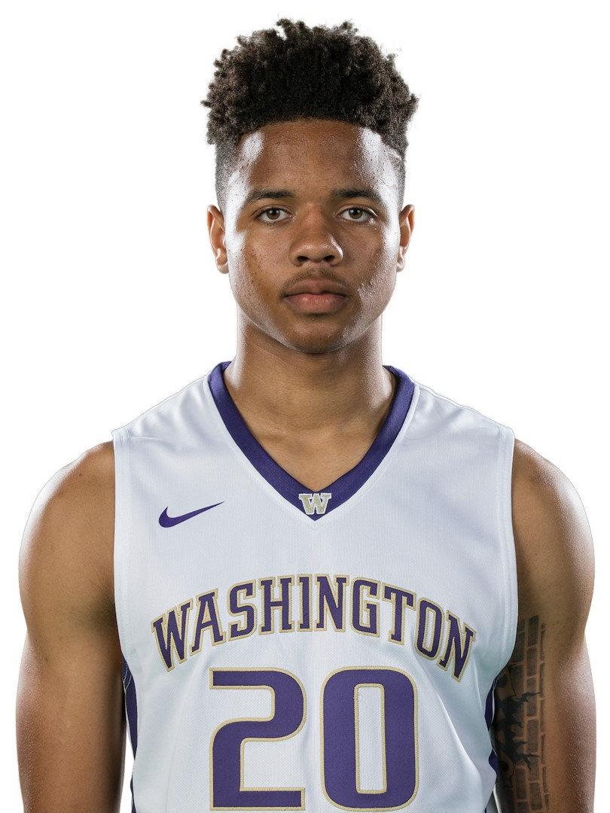







GIVEN THESE STATS, WE RECOMMEND…
AVOIDING:
Memphis
Purdue
Creighton
DRAFTING FROM:
Central Michigan
New Mexico State
Washington

Slide 22
What we learned:
It is extremely easy to produce consistently bad players, and
very hard to produce
consistently good players

Slide 23
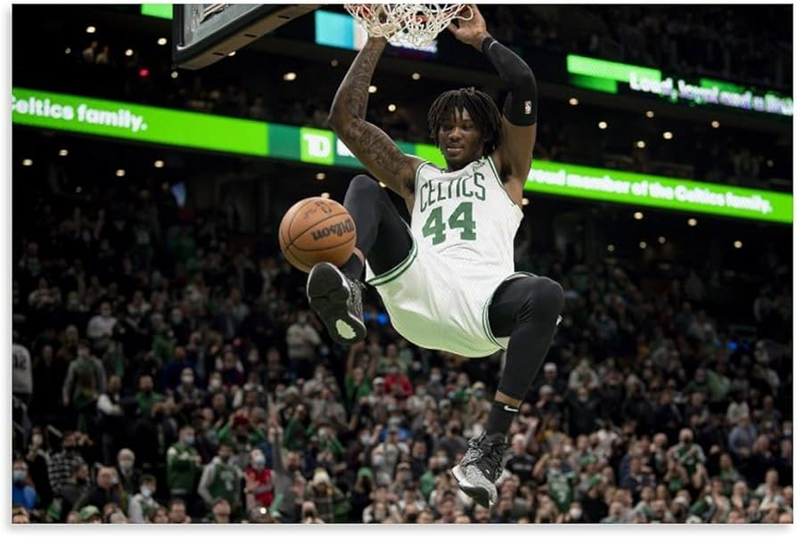
HOW WE COULD IMPROVE OUR DATA
WEIGH MORE RECENT DATA MORE TO SHOW TRENDS
MAKE SURE ALL HISTORICAL DATA IS INCLUDED
ADJUST SCALING BASED ON TEAM SIZE
WEIGH THE AVERAGE RATINGS AND DEVIATION DIFFERENTLY

Slide 24
THANKS!
DO YOU HAVE ANY QUESTIONS?

